Slide 1
Optimizing Hotel Room Pricing for Revenue Maximization

Slide 2

Executive summary of the analysis and recommendations
Data Overview: We analyzed booking data from Azure Hotels, covering various aspects such as hotel type, booking status, lead time, and average daily rate (ADR).
Key Findings:
Cancellation Patterns: Cancellation rates and booking statuses vary across hotel types.
ADR Insights: Average Daily Rate (ADR) shows variability depending on the hotel type and booking attributes.

Slide 3

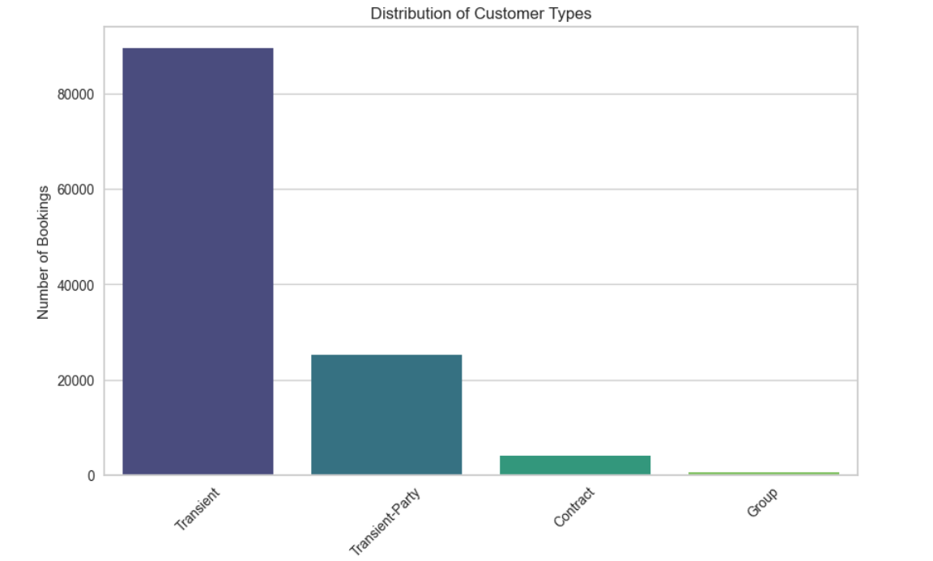
Example: "In our analysis, we segmented Azure Hotels' customers into four distinct groups based on booking behavior and demographics. We forecasted future demand using advanced time series models and compared our pricing with competitors. Our recommended pricing strategy aims to leverage these insights to enhance revenue by 15% and improve overall profitability by adjusting prices dynamically based on demand forecasts and competitor pricing."

Slide 4
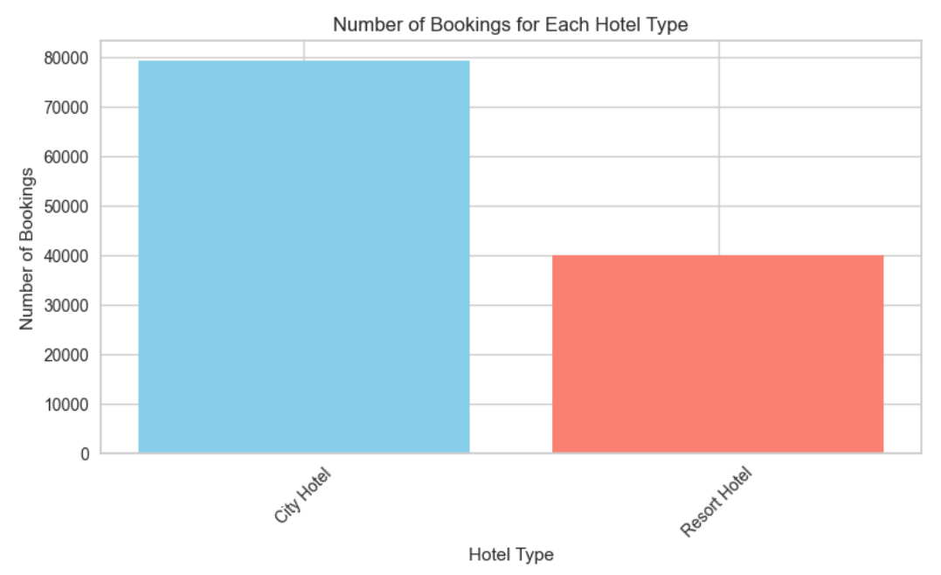
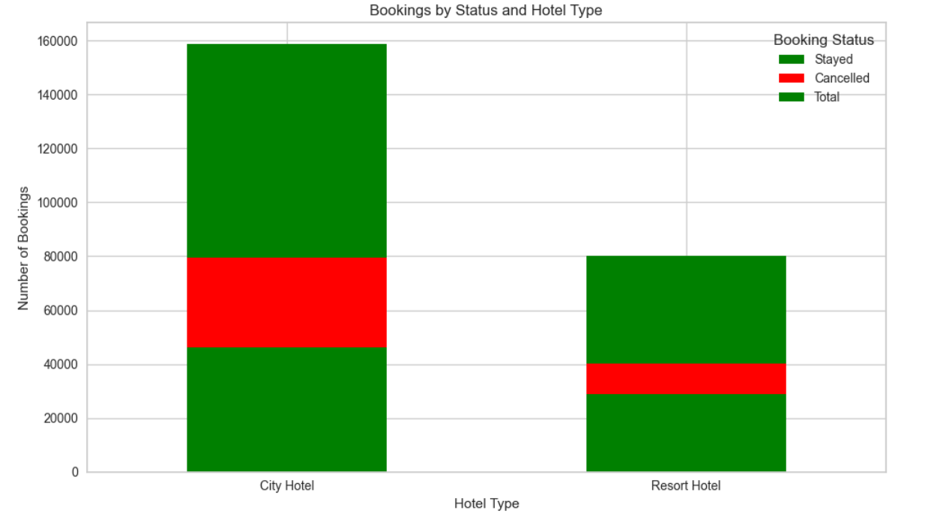
Hotel Types: There is a significant difference in booking patterns between Resort Hotels and City Hotels.
Cancellation Patterns: Cancellation rates and booking statuses vary across hotel types.

Slide 5
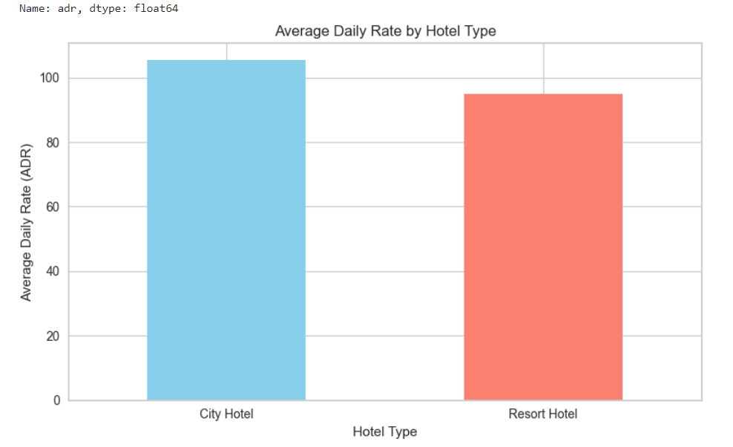
ADR Insights: Average Daily Rate (ADR) shows variability depending on the hotel type and booking attributes
Recommendations:
Implement a dynamic pricing strategy based on booking patterns, hotel type, and demand forecasting.
Introduce differentiated pricing strategies for Resort and City Hotels to maximize revenue and occupancy.
Adjust prices based on lead time and booking status to reduce cancellations and increase profitability.

Slide 6
Overall Analytical Approach / Architecture
Data Collection:
Source: Booking data from Azure Hotels in Excel format.
Variables: Included hotel type, booking status, lead time, ADR, customer demographics, and booking details.
Data Processing:
Cleaning: Handle missing values and inconsistent data entries.
Transformation: Encode categorical variables and derive new metrics like booking lead time and ADR.
Analysis Methods:
Descriptive Statistics: Understand distributions and central tendencies.
Segmentation Analysis: Identify customer segments based on booking attributes and demographics.
Visualization: Use bar plots, pie charts, and cross-tabulations to illustrate findings.

Slide 7
Customer Segment Analysis and Profiling
Segmentation:
Customer Types: Segment based on demographics (e.g., adults, children), booking behavior (e.g., repeated guests), and booking channels (e.g., Travel Agents, Tour Operators).
Booking Patterns: Analyze patterns of booking status, lead time, and special requests.
Profiling:
Resort Hotel Guests: Typically stay longer, have higher ADR, and may prefer different meal plans.
City Hotel Guests: Often book for shorter durations and might have different booking channels and cancellation patterns.
Visualization:
Booking Distribution: Show distribution of bookings and cancellations across customer segments.
ADR Comparison: Compare ADR across different segments.

Slide 8
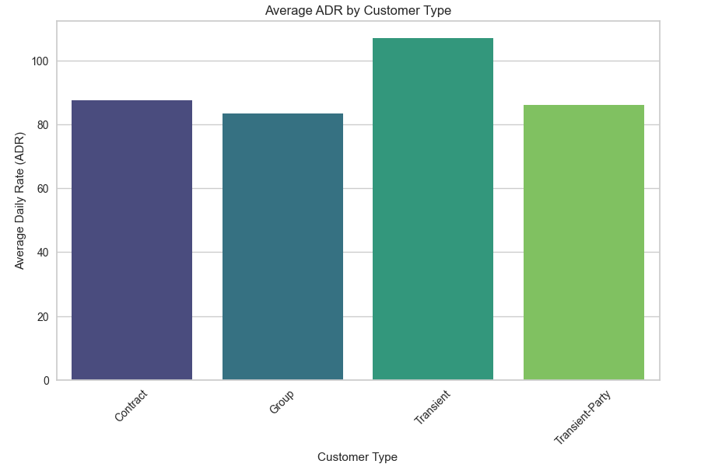

Slide 9
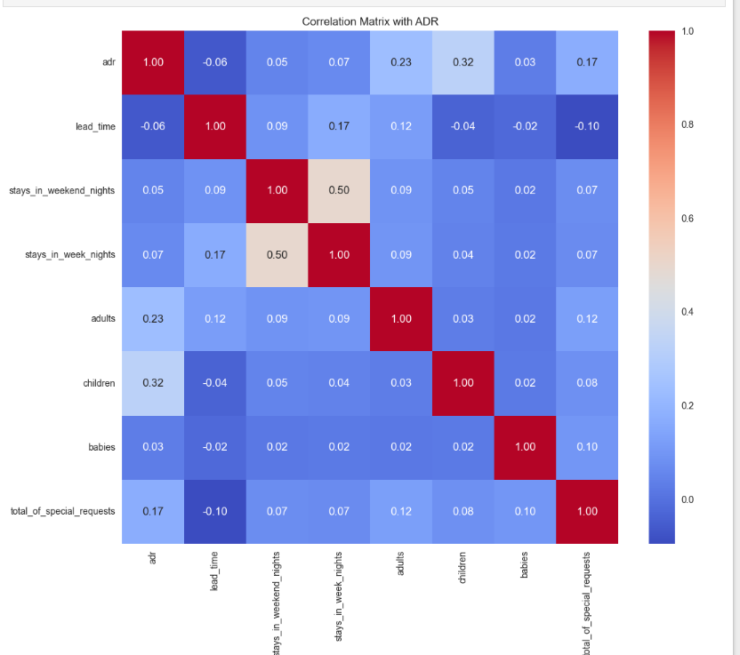

Slide 10
Recommended Pricing Strategy and Expected Impact
Dynamic Pricing Strategy:
Segmentation-Based Pricing: Implement different pricing strategies for Resort and City Hotels.
Demand-Based Adjustments: Use dynamic pricing models to adjust rates based on demand forecasts and competitor pricing.
Lead Time Discounts: Offer discounts for early bookings and premium pricing closer to the arrival date.
Expected Impact:
Revenue Growth: Increased revenue through optimized pricing aligned with demand and booking patterns.
Reduced Cancellations: Lower cancellation rates by adjusting prices according to booking status and lead time.
Increased Occupancy: Improved occupancy rates by targeting different customer segments with tailored pricing.

Slide 11
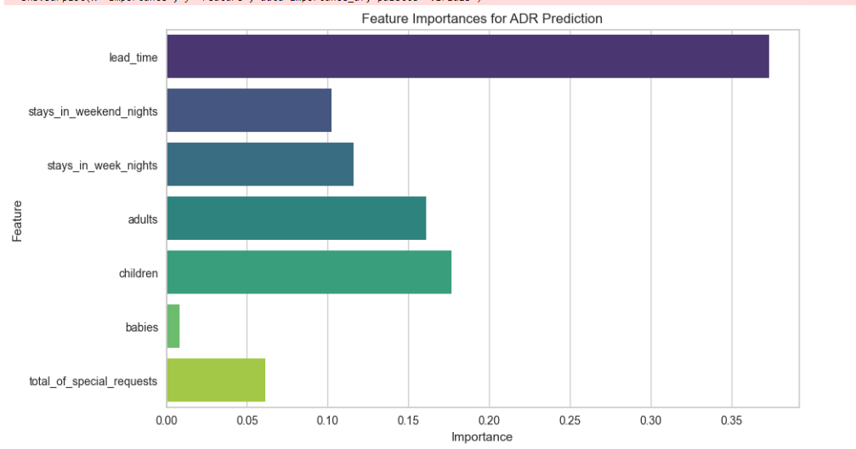

Slide 12
6. Conclusion and Next Steps
Conclusion:
The analysis highlights key areas where pricing strategies can be optimized to enhance revenue and profitability.
Customer segmentation and pricing driver analysis provide a foundation for implementing effective pricing strategies.
Next Steps:
Implement Recommended Pricing Strategies:
Test dynamic pricing models and segmentation-based offers.
Adjust cancellation policies and track their impact on bookings.
Continuous Monitoring:
Regularly review booking data and market trends to adjust pricing strategies as needed.
Conduct periodic analyses to refine customer segmentation and pricing approaches.
Feedback and Adjustment:
Gather feedback from customers and adjust strategies based on performance and customer satisfaction.
Additional Actions:
Consider using advanced analytics tools for ongoing revenue management and pricing optimization.

Slide 13

Thank you
This PPT provides a comprehensive overview of dataset analysis and recommendations.

